Slide 1
Measurement – Area
Miss Lum
Year 11 Essentials

Slide 2

Learning Outcomes
1.3.5 Choose and use appropriate metric units of area, their abbreviations and conversions between them
1.3.6 Estimate the areas of different shapes
1.3.7 Convert between units of area and other area units
1.3.8 Calculate areas of rectangles, triangles, and composite shapes

Slide 3
24
7
30
Area
Date: /03/2018
EQ – How do we find the area of compound shapes?
What are compound shapes?
A compound shape is a 2D shape made of more than one shape.
Examples
Notes:
Placemat Activity
Strategise how to calculate the area of compound shapes in general.
Allow students to develop strategies.
Discuss different approaches. There can be more than one valid approach.

Slide 4
24
7
30
Area
Date: /03/2018
EQ – How do I find the area of composite shapes?
How do we calculate the area of compound shapes?
To find the area of compound shapes, split them up into their composite shapes.
Find the area of each shape, then add them together

Slide 5
Guided Practice
8cm
Area A = 8 x 5
= 40cm²
A
5cm
Area B = 11 x 2
= 22cm²
B
Total Area = 40 + 22
= 62cm²
11cm
2cm

Slide 6

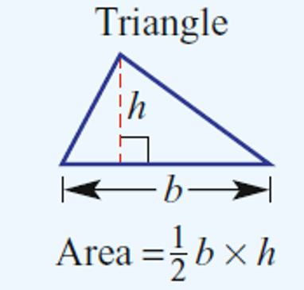
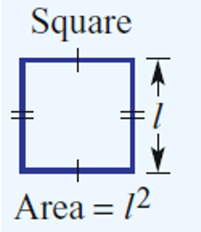
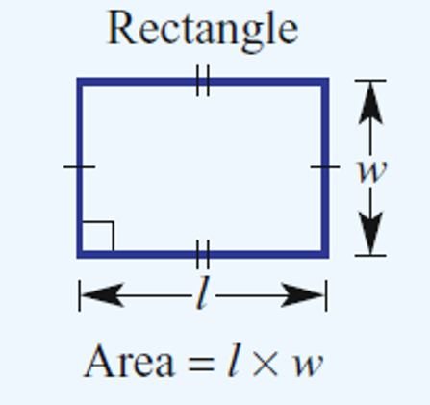
Task
Complete the Composite Area worksheet. The area formulas that you need are these:

